Slide 1

Bridging the Theory-Practice Gap through Design Thinking
Awais Sheikh – asheikh@mitre.org
Cynthia Gilmer – cgilmer@mitre.org
The authors’ affiliation with The MITRE Corporation is provided for identification purposes only, and is not intended to convey or imply MITRE''s concurrence with, or support for, the positions, opinions, or viewpoints expressed by the authors.
Approved for Public Release; Distribution Unlimited. Case Number 17-2683
Notes:
Awais
All graphics in this presentation are licensed through creative commons and available for reuse.

Slide 2
What is the gap and how can Design Thinking help?
How might we make research (usually designed and conducted by scholars) more relevant to those who may benefit from the research (practitioners)?
While some scholars advocate co-designing research with practitioners, i.e., insider/outsider team research (Louis & Bartunek, 1992), practical guidance is limited.
Design Thinking can provide a framework that helps scholars and practitioners co-create meaningful research that is both relevant and useful to management practitioners, and contributes new knowledge.
©2017 The MITRE Corporation. ALL RIGHTS RESERVED
Notes:
Awais
This slide provides an overview of the theory-practice gap, which is also referred to in the literature as the “scholar-practitioner gap”.
Cite the following
Insider/outsider team research
Jean Bartunek, Meryl Reis Louis
Sage Publications, May 14, 1996
The joint relationships between outside researchers and the people inside the setting being researched are examined in Insider/Outsider Team Research. Jean M. Bartunek and Meryl Reis Louis consider not only the relationship between insider and outsider but also the implications for the quality of knowledge gained from such research. The book begins with a consideration of the theoretical bases of insider/outsider research, provides a primer on conducting such research, and contains an extended example of insider/outsider collaboration. Finally, the authors examine the practical and ethical challenges inherent to this sort of research. Insider/Outsider Team Research will be an invaluable guide to the organizational researcher.

Slide 3
Agenda
Overview of Design Thinking
Scenario for Activities
Design Thinking Activities
  Exploring the Problem Space
  Generating Ideas
  Prototyping Solution Concepts
Our Experiment Applying Design Thinking to the Research & Development Process
Q&A
©2017 The MITRE Corporation. ALL RIGHTS RESERVED
Notes:
Awais
Emphasize that we have done this to some success already internally within MITRE and will be sharing our lessons learned after we walk through the workshop activities

Slide 4
Definition of Design Thinking
Sample of Definitions
“A discipline that uses the designer’s sensibility and methods to match people’s needs with what is technologically feasible and what a viable business strategy can convert into customer value and market opportunity” (Brown & Katz, 2011).
“A human centered innovation process that emphasizes observation, collaboration, fast learning, visualization of ideas, rapid concept prototyping, and concurrent business analysis” (Lockwood, 2011)
“A style of thinking that combines empathy for the users and immersion in the context of a problem, creativity in the generation of insights and solutions, and a data-based experimental approach to assessing the quality of solutions.” (Liedtka & Ogilve, 2011).
Key Features of Definitions
Focused on problem identification through customer empathy and solution development through iterative and rapid prototyping
Human-centered throughout the entire process
Includes processes, tools, and techniques to achieve its objectives; can be considered a methodology
©2017 The MITRE Corporation. ALL RIGHTS RESERVED
Notes:
Cindy
There is no one universal definition of Design Thinking. This slide shows definitions from three of the leading researchers and practitioners of design thinking. The common elements between the definitions yield that Design Thinking is a human-centered problem solving approach that emphasizes empathy with end-users or customers and rapid prototyping. While Design Thinking got its start in product development, it has since expanded in recent years and is being used in a variety of settings.

Slide 5
Design Thinking is appropriate for the following situations
We must rely heavily on deep understanding of actual people involved
We have a hunch about the problem and/or opportunity
Have a need to understand a process or product from the human perspective in order to improve it or make it more relevant to the users’ needs
There are many unknowns and past data are unlikely to help us
We haven’t seen this problem before and so we’re not sure where to start
Very little existing data to analyze
©2017 The MITRE Corporation. ALL RIGHTS RESERVED
Notes:
Cindy
Design Thinking is not a silver bullet. The circumstances in which Design Thinking can be most useful is to address “wicked problems” which are defined in the literature as problems that are large, complex, and filled with uncertainties. Design Thinking can help provide a structured way to explore these types of problems in a data driven fashion by a combination of qualitative techniques to obtain insights as well as hypothesis testing of various alternatives.

Slide 6
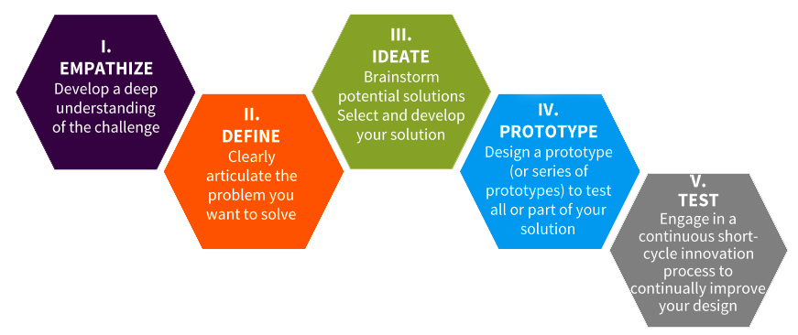
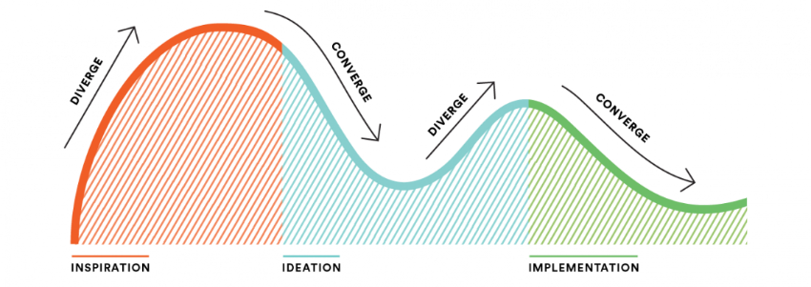

Design Thinking Process
Stanford Design School¹
IDEO²
UVA Darden³
Stanford Bootcamp Bootleg (https://dschool.stanford.edu/resources/the-bootcamp-bootleg)
IDEO.org Approach Site (https://www.ideo.org/approach)
Jeanne Liedtka Design Thinking for Business Innovation (http://jeanneliedtka.com/)
©2017 The MITRE Corporation. ALL RIGHTS RESERVED
Notes:
Cindy
This slide shows various different depictions of the Design Thinking process by leading academic and practitioner groups. While they have some variation, they all begin with exploring a problem space through empathizing with customers or the end-user using ethnographic techniques. There is also a component of ideation in each process. Ideation refers to structured brainstorming that emphasizes divergent then convergent thinking to develop many out-of-the-box ideas and then focus the team on selecting a subset of those ideas to take further. The tail end of all of the processes include iterative prototyping and testing ideas for feedback. As we will discuss, prototypes here do not refer to “proofs of concept” but rather low-fidelity prototypes that are encouraged to get feedback.
While all of the processes are depicted as linear, in reality, the process steps are iterative. For example, after prototyping an idea, the team may uncover another problem area that needs to be explored and ideated.
For the remainder of this briefing, we will use the Stanford process.

Slide 7
Scenario for Activities
This scenario provides a shared context for workshop participants to become familiar with the Design Thinking process.
Each table will be working to identify ways to revamp existing Academy of Management publications to be more accessible to management practitioners, a goal that has been stated by the AMJ’s outgoing editor last year.
  Our collective efforts at dissemination have improved vastly over the past decade as we consider innovative ways to get the attention of scholars and practitioners alike. Yet, this marks the beginning of a trend under which progress in our field will not just be about publications, but about outcomes and impact (George, 2016).
The scope of discussion during the workshop can include improvements to existing publications (e.g. Academy of Management Journal, Academy of Management Perspectives, etc.) or alternative ways to communicate research with practitioners.
©2017 The MITRE Corporation. ALL RIGHTS RESERVED
Notes:
Awais

Slide 8
ACTIVITY 1
Exploring the Problem Domain
Notes:
Awais

Slide 9
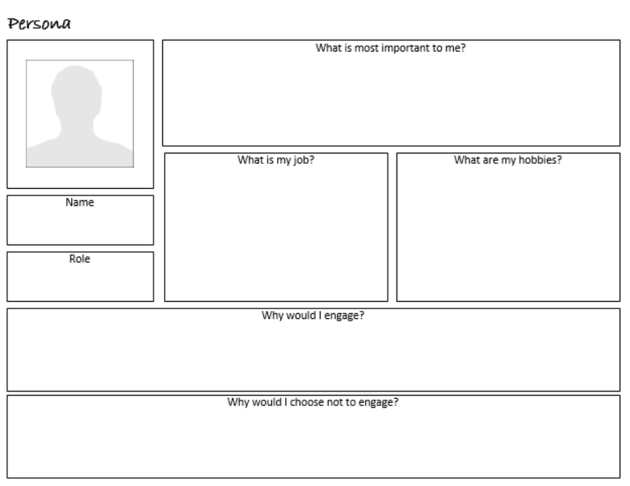
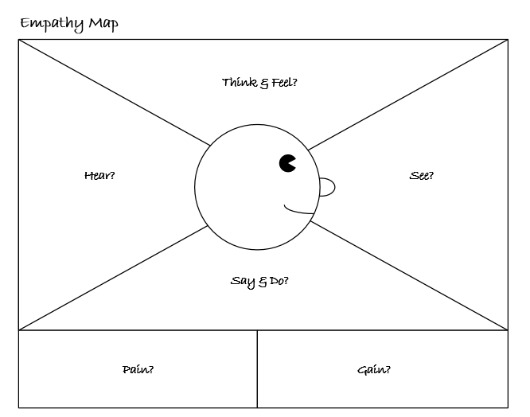
Exploring the Problem
Domain
Design Thinking emphasizes exploring problem domains from a human-centered perspective
Personas help designers get to know their intended audience
Empathy Maps are used to explore how someone perceives and reacts to their surroundings
©2017 The MITRE Corporation. ALL RIGHTS RESERVED
Notes:
Awais
The first portion of the Design Thinking process is geared on exploring the problem domain. The phases of the Design Thinking process that aligns with problem exploration is the “Empathize” and “Define” phase. In keeping with the principles of Design Thinking, the emphasis in these phases is understanding the customer’s perspective and reframing problem statements that drive the rest of the process.
The primary method for gaining these insights is through observation and interviews with customers to understand their perspective.
There are a few tools shown here which are used in these phases. The first is the empathy map, which is used to help put ourselves in the shoes of the customer and understand what they’re seeing, hearing, thinking/feeling, and saying/doing. By putting ourselves in the shoes of the customer, we can identify pains and gains which serve as insights that may shape problem statements.

Slide 10


Exploring the Problem Domain: Activity Instructions
Time Allotted: 30 minutes
Flip Chart
Stickies
Empathy Map Poster
Activity Goal: Better understand the practitioner’s view of the content in the existing Academy of Management Journal and define some problem statements that can be used to brainstorm solutions.
Steps:
List on a flip chart sheet various stakeholders who might be considered target practitioners for management research.
Select one stakeholder group, and try to define a persona that embodies that stakeholder group on a flip chart. Personas should be detailed in that they should have a name, a title, the company/organization they work for, number of years of experience, level of education, work and personal habits, etc.
Using the template provided, complete an Empathy Map based on the persona. The empathy map should reflect the perspective of the persona reading an existing AOM publication. Use sticky notes and add your insights to the Empathy Map.
Develop problem statements based on the insights gained. Problem statements should be in the format of “How Might We…” and are meant to frame different aspects of the problem. Write these statements on sticky notes and post them on flip chart.
©2017 The MITRE Corporation. ALL RIGHTS RESERVED
Notes:
Awais
This will be a facilitated activity which will be walked through with the audience.
Scenario: Each table will be working to identify ways to revamp the existing Academy of Management Perspectives Journal the empirical research journal for AOM, to be more accessible to management practitioners. We will be using this scenario to get familiar with the Design Thinking Process.
For this first activity, we want to borrow from the Empathy and Define approaches to better understand the practitioner viewpoint to the existing Academy of Management Journal and define some problem statements which we can use to brainstorm solutions.
To do this, the first step is for each table to discuss who are some of the practitioners that the Academy of Management is geared towards. The teams should first list various stakeholders (e.g. executives, academics, consultants, etc.). Then, the team should take one or two of these stakeholder groups, and try to define the beginnings of a persona that embodies that stakeholder. Personas should be detailed in that they should have a name, a title, the company/organization they work for, number of years of experience, level of education, work and personal habits, etc.
The next step will be to take one of these personas, and complete an Empathy Map. The empathy map allows the team to reflect on the experience of a persona by helping to put the team into their shoes. The empathy map should be completed based on the perspective of this persona reading an Academy of Management Journal issue. The team should reflect on what that persona would see, what they might hear, what they may think and feel, and what they may say.
The final step will be to develop problem statements based on the insights gained. Problem statements should be in the format of “How Might We…” and are meant to frame different aspects of the problem.

Slide 11
Exploring the Problem Domain Activity: Debrief and Lessons Learned
Implications for the Scholar-Practitioner Gap
Researchers who engage with practitioners to understand the types of problems they face are better able to identify relevant research topics.
Treating practitioners as end-customers of research helps academics understand their challenges in consuming research.
©2017 The MITRE Corporation. ALL RIGHTS RESERVED
Notes:
Awais

Slide 12
ACTIVITY 2
Generating Ideas
Notes:
Cindy

Slide 13
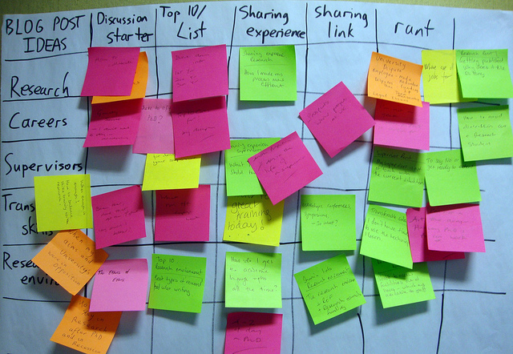
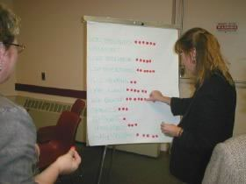
Generating Ideas
Design Thinking approaches ideation from a perspective of divergent then convergent thinking
Divergent thinking allows innovators to generate a lot of ideas and build upon ideas to improve them
Convergent thinking helps designers identify the best ideas to take forward to experimentation
©2017 The MITRE Corporation. ALL RIGHTS RESERVED
Notes:
Cindy
The next portion of the Design Thinking process is known in most frameworks as “ideation”. While there have always been various techniques and best practices for brainstorming that have existed, Design Thinking suggests a structured approach for the process that emphasizes divergent thinking initially to identify a large number of ideas from different perspectives without judgement, and then convergent thinking to refine those ideas and select the ones that are worth considering. It is important to note that the ideas coming out of this phase are hypotheses that will be tested through prototypes. In keeping with the iterative nature of Design Thinking, the team may return to ideation several times in the process.

Slide 14
Generating Ideas:
Activity Instructions
Time Allotted: 25 minutes
Flip Chart
Stickies
Dot Stickers
Activity Goal: Use the problem statements developed in the last activity to generate ideas for making the chosen AOM journal more accessible to practitioners following the Design Thinking approach of divergent and then convergent thinking.
Steps:
Table participants list as many ideas as they can on improvements to the selected journal based on the problem statements. Do not limit your improvements to any one area, but think about changes in terms of content of the journal, format of the journal, delivery channels for the journal, etc. Write each idea on a sticky note and place all ideas on a flip chart sheet.
Group the ideas into categories that make sense to the team by physically moving stickies into groups; label each group. These labels represent your solution concepts.
Dot-vote on each solution concept. Each member of the team gets three dots to use as they see fit. For example, if you are passionate about one solution concept, assign all three of your dots to that concept. If you feel there are three different concepts that would be beneficial, then vote one dot for each concept. After all teams have voted, choose the “winning” concepts for the next step.
©2017 The MITRE Corporation. ALL RIGHTS RESERVED
Notes:
Cindy
This will be a facilitated activity which will be walked through with the audience.
Now we will use the problem statements we developed in the last activity to generate ideas. We will be following the Design Thinking approach of divergent and then convergent thinking.
The first step will be for each member of the team to come with as many ideas as they can on improvements to the Academy of Management Journal based on the problem frames. Teams should be encouraged to think broadly and not limit your improvements to any one area, but think about changes in terms of content of the journal, format of the journal, delivery channels for the journal, etc. Each idea should be written on a sticky note and placed along with everyone else’s.
The team will then group the ideas into categories that make sense to the team by physically moving stickies into groups and labeling each group. This starts to take individual ideas and group them into solution concepts.
The final step will be to dot-vote on each solution concept. Each member of the team will have three “dots”. They can distribute these dots to the solution concepts as they see fit. For example, if they are passionate about one solution concept, they can assign all three of their dots to that concept. If they feel there are three different concepts that would be beneficial, they can distribute one dot to each concept. After all teams have assigned their dots, the concepts with the most dots will be the one to be explored further.
These concepts serve as “hypotheses” that should be explored further in the next phases

Slide 15
Generating Ideas Activity:
Debrief and Lessons Learned
Implications for the Scholar-Practitioner Gap
Diverse research teams can provide novel and high quality ideas
Involving practitioners in the process of developing research ideas can maximize the adoption of those ideas in practice environments
©2017 The MITRE Corporation. ALL RIGHTS RESERVED
Notes:
Cindy

Slide 16
ACTIVITY 3
Prototyping Solution Concepts
Notes:
Awais

Slide 17
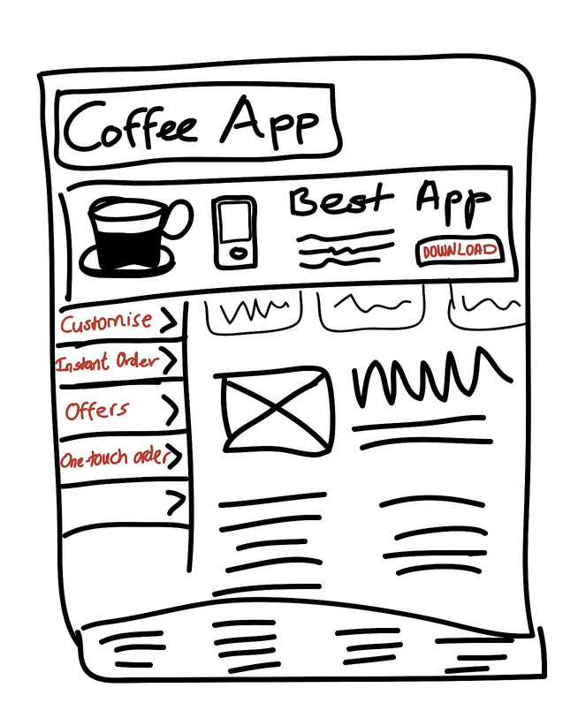
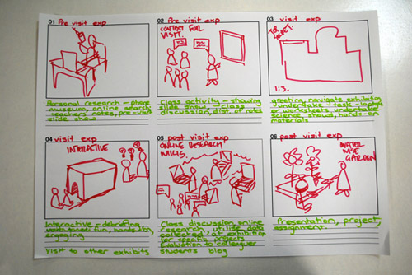
Prototyping Solution
Concepts
Design Thinking encourages frequent feedback through the use of low-fidelity prototypes
Storyboarding allows designers to describe a scenario or experience to allow potential customers to react
Wireframes allow designers to explore potential designs with users to understand what works and what doesn’t
©2017 The MITRE Corporation. ALL RIGHTS RESERVED
Notes:
Awais
Again, we think of the results of the Ideation phase as hypotheses. The next phase is to prototype and test these ideas. When we talk about prototyping in Design Thinking, it is usually a low-fidelity prototype, which means it is a simplistic representation of the idea that can elicit feedback quickly as opposed to a “proof of concept”. Prototypes can also be done for ideas that are not products through techniques like storyboards, which are used for prototyping service ideas, and wireframes, which are used for IT systems.

Slide 18
Prototyping Solution Concepts: Activity Instructions
Time Allotted: 15 minutes
Flip Chart
Activity Goal: Develop a low-fidelity prototype for a solution concept to take to AOM journal editors to show how the journal could be made more accessible to practitioners.
Steps:
Take the top solution concepts and develop a poster that describes the new and improved journal. The posters should include visuals and a tagline. Remember the purpose of the poster is to obtain feedback on the solution concept, not to necessarily design a “proof of concept.”
Feel free to refer to lower-ranked solution concepts from the previous activity to see if any of their features can be incorporated into the solution poster.
©2017 The MITRE Corporation. ALL RIGHTS RESERVED
Notes:
Awais
For our scenario, the prototype we will generate for feedback will be a “solution poster”. Each team will take their top solution concepts and develop a poster that describes the new and improved Academy of Management Journal. The posters should include visuals and a tagline. Remember the purpose of the poster is to obtain feedback on the solution concept, not to necessarily design a “proof of concept”

Slide 19
Prototyping Solution Concepts Activity:
Debrief and Lessons Learned
Implications for the Scholar-Practitioner Gap
Researchers need to involve practitioners early and often throughout research
Feedback can validate the relevance of the research to practitioners, and can identify practical implications to guide current and future research focus
©2017 The MITRE Corporation. ALL RIGHTS RESERVED
Notes:
Awais

Slide 20
Our Experiment Applying Design Thinking to the R&D Process
What we did
  Applied Design Thinking to help engage practitioners into the research development process earlier than had been done before
  Focused on scoping problem statements using Design Thinking tools and leveraging those problem statements to develop research ideas
What we learned
  Important to scope the initial problem domain as not too broad and not too narrow
  Applying this process takes time, resources, and advance planning; the investment helps with successful adoption of research by practitioners
  Design Thinking methods are not a substitute for domain knowledge of the subject area
  Important to communicate Design Thinking principles to participants ahead of time: ensure they understand they are expected to explore problems, not push preconceived solutions
What we hope to do next
  Improve and more broadly apply the Design Thinking process to research, including prototyping and testing phases
  Assess the impact of applying Design Thinking in the research development process by measuring transition of research to operational contexts
©2017 The MITRE Corporation. ALL RIGHTS RESERVED
Notes:
Cindy and Awais
This slide represents our own lessons learned in applying Design Thinking to MITRE’s internal research program over the past fiscal year.

Slide 21
Q&A

Slide 22
References
Brown, T., & Katz, B. 2011. Change by design: how design thinking transforms organizations and inspires innovation. New York, NY: Harper Business.
George, G. 2016. Management Research in AMJ: Celebrating Impact While Striving for More. Academy of Management Journal, 59: 1869-1877. doi: 10.5465/amj.2016.4006
Liedtka, J., & Ogilvie, T. 2011. Designing for growth: a design thinking tool kit for managers. New York: Columbia University Press.
Lockwood, T. 2011. Design thinking: integrating innovation, customer experience and brand value. New York: Allworth Press.
Louis, M. R., & Bartunek, J. M. 1992. Insider/Outsider Research Teams. Journal of Management Inquiry, 1: 101-110. doi:10.1177/105649269212002
©2017 The MITRE Corporation. ALL RIGHTS RESERVED

