Slide 1
MITRE Corporations Learning System: Project Workbooks
Jay Crossler and Lisa Glikbarg

Slide 2
3 Dimensions Support “Mission First” MITRE’s Center for Programs and Technology
People: Empower you to grow and develop through our Purpose, Mastery, Autonomy culture
We want you to feel safe to seize opportunities and knock down obstacles.
How do we help our talented people accomplish more?
Process: Reduce well intended processes/bureaucracy - train and trust our people more
We will improve processes that advance the quality of our work and our people.
Our staffing process will be improved and include ways to provide developmental opportunities by greater use of intentional on-the-job team work assignments.
A learning system is being developed to capture, share, and coach everyone on our leading practices so we can all learn faster together.
Technology: Increase the impact of our technology investments to maximize mission impact
We are committed to solving problems for a safer world

Slide 3
3 Dimensions Support “Mission First” MITRE’s Center for Programs and Technology
Today, we will focus on these two areas of the MITRE’s CPT Vision
People: Empower you to grow and develop through our Purpose, Mastery, Autonomy culture
We want you to feel safe to seize opportunities and knock down obstacles.
How do we help our talented people accomplish more?
Process: Reduce well intended processes/bureaucracy - train and trust our people more
We will improve processes that advance the quality of our work and our people.
Our staffing process will be improved and include ways to provide developmental opportunities by greater use of intentional on-the-job team work assignments.
A learning system is being developed to capture, share, and coach everyone on our leading practices so we can all learn faster together.
Technology: Increase the impact of our technology investments to maximize mission impact
We are committed to solving problems for a safer world

Slide 4
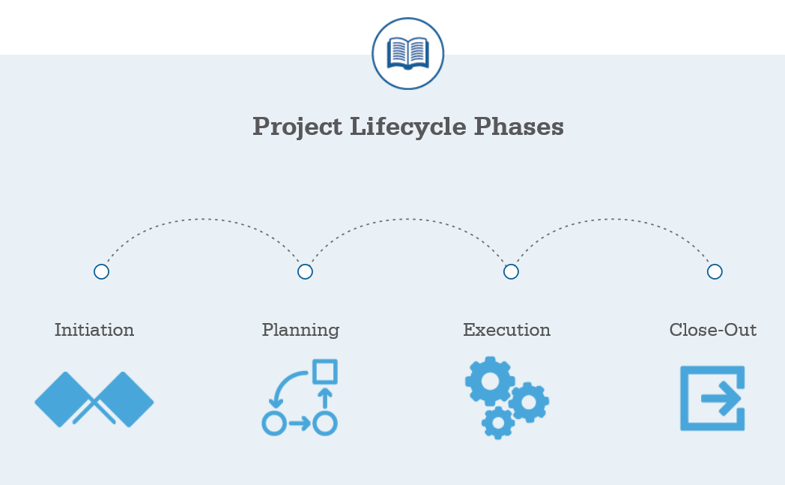
Project Workbook
The Project Workbook is designed as a living document that brings to the fingertips of MITRE staff the following content directly linked to the project scope of work;
Lessons Learned
Leading Practices
Staffing recommendations
Knowledge assets from active and past projects within MITRE and Industry
This content is organized around MITRE’s Project Lifecycle to allow staff to get the latest content associated to their phase of work

Slide 5
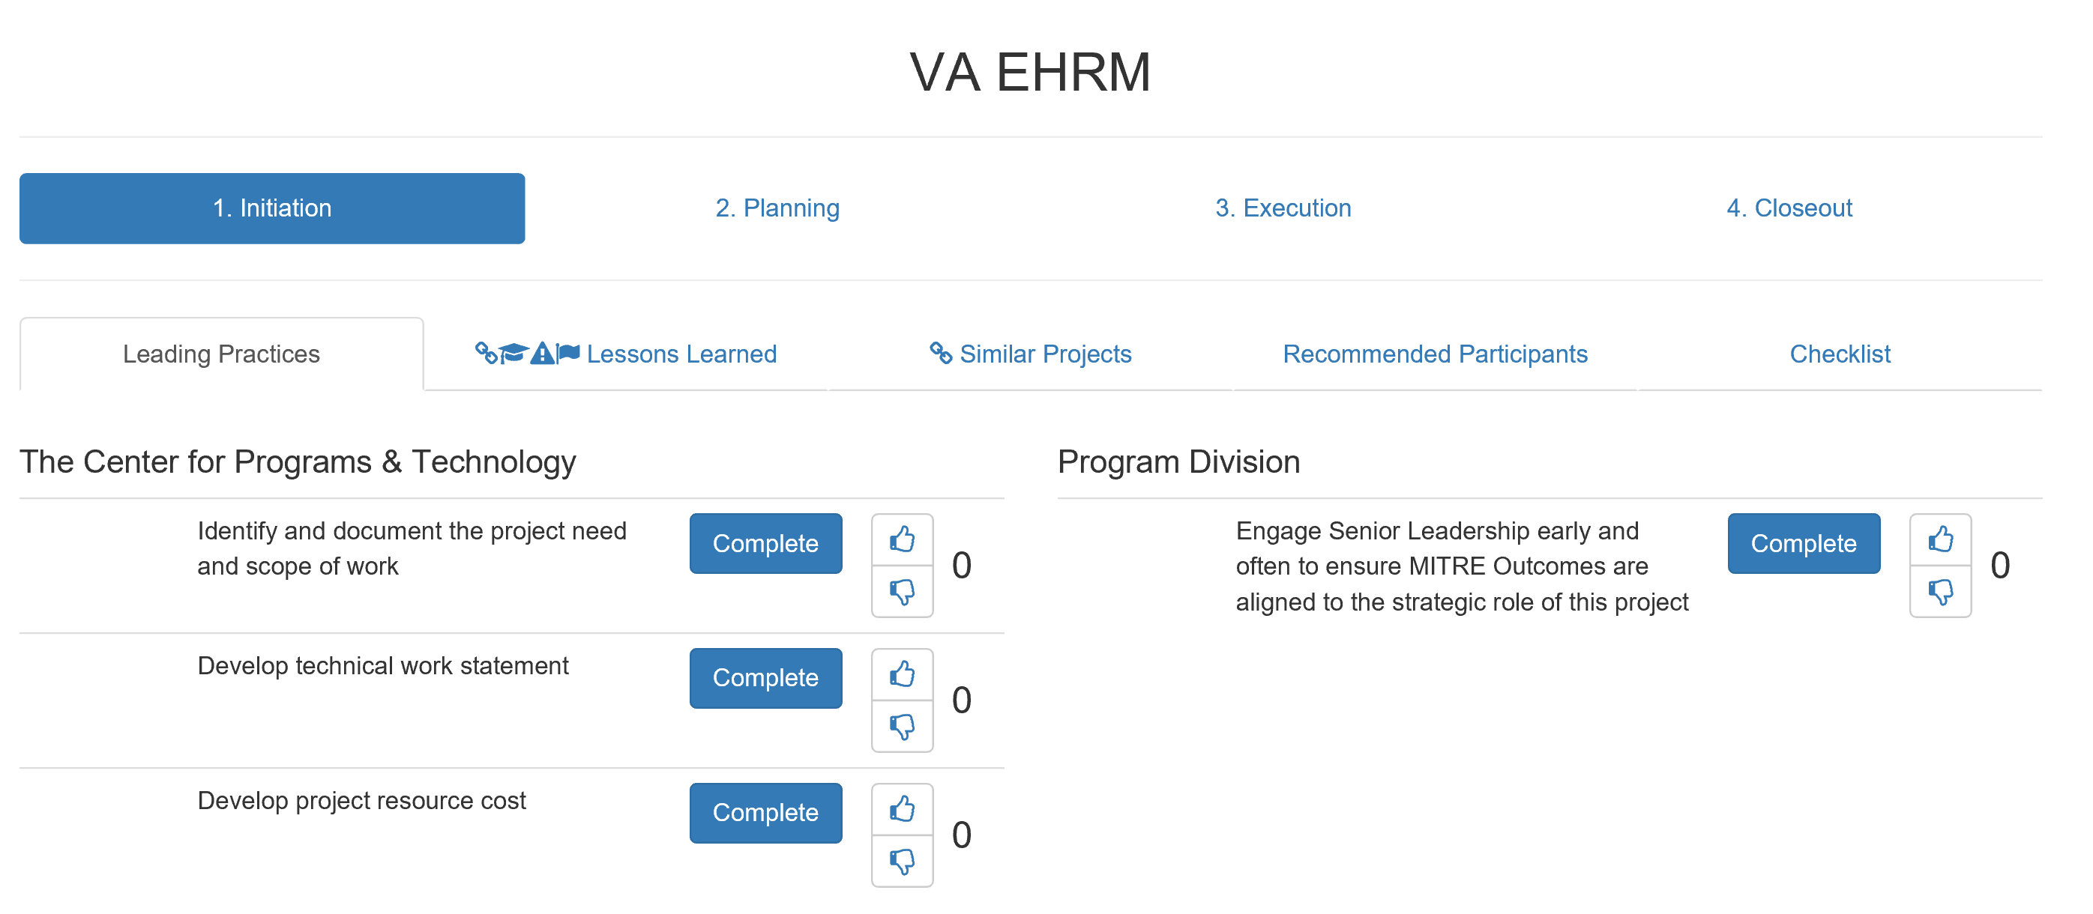
Project Workbook Design
Veterans Affairs Project 1

Slide 6
Project Workbooks Sources
Project Workbook content is extracted from a variety of Learning System sources across MITRE including:
Discuss@MITRE
Tools@MITRE
MITRE Product Libraries
SharePoint Sites
Staff Planning and Management Tools
Project Pages
Infodesk Services
Handshake Sites
Wiki Pages
Technology Exchange Meetings

Slide 7
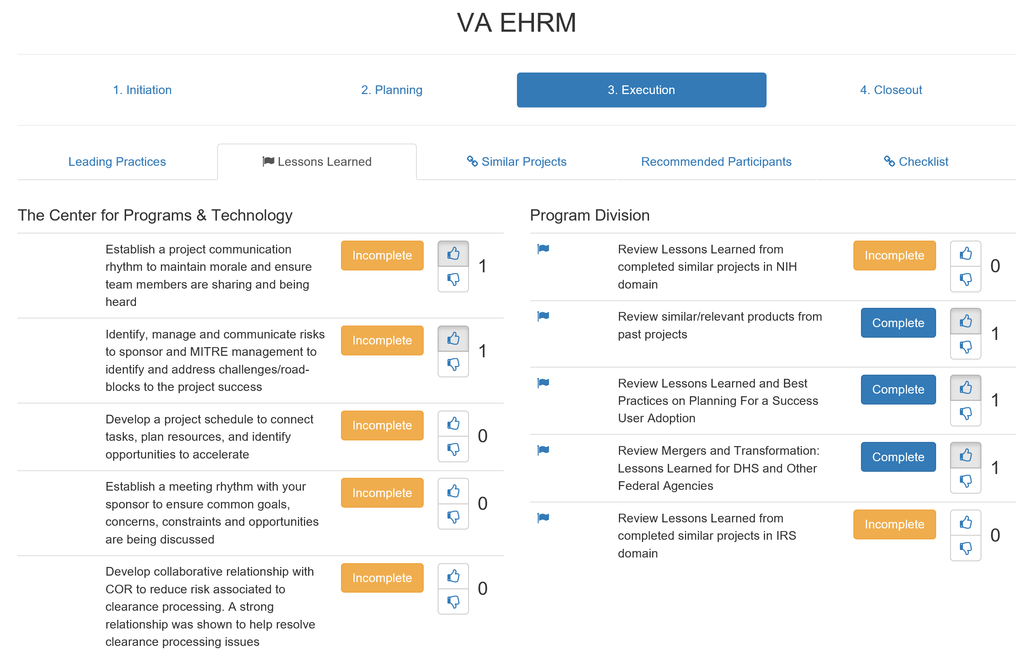
Project Workbooks: Lessons Learned
Veterans Affairs Project 1

Slide 8
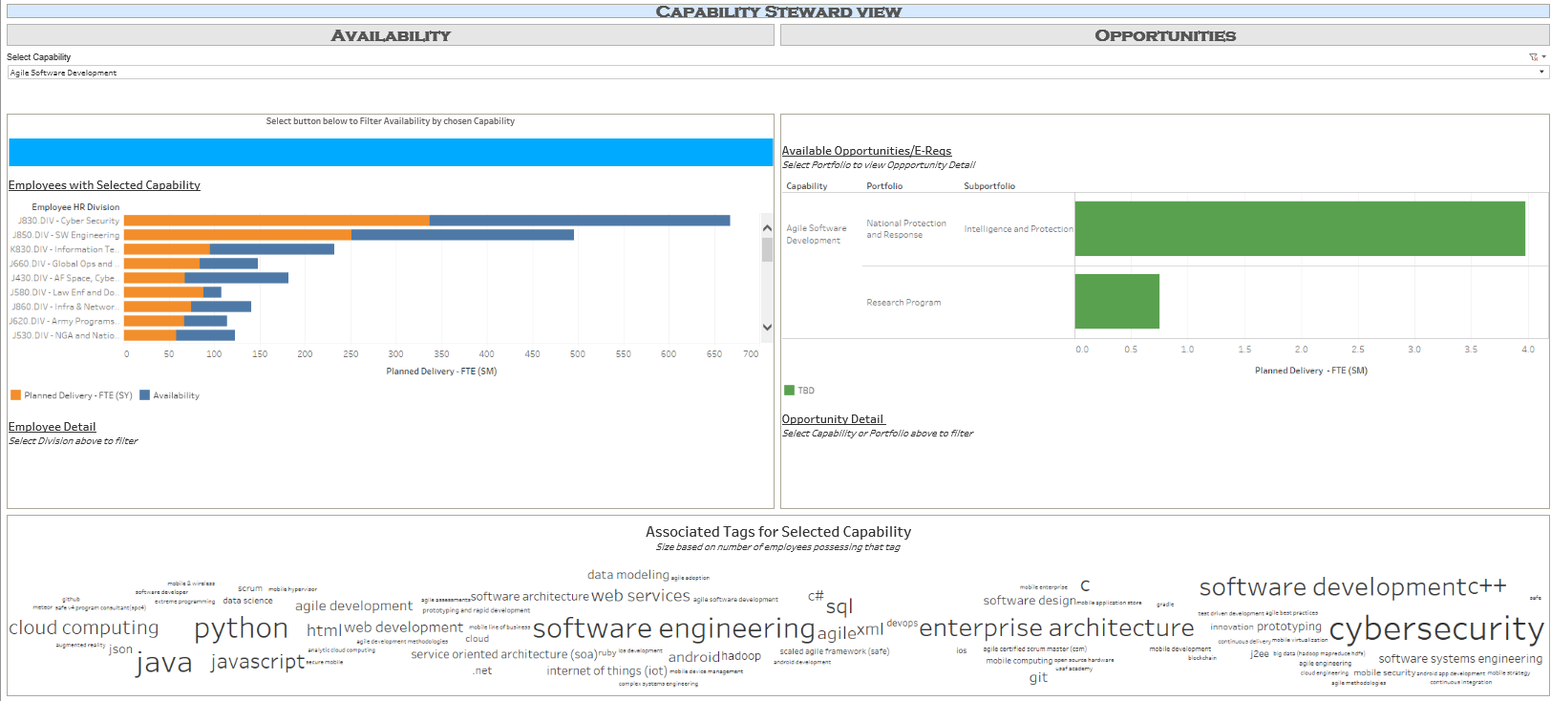
Project Workbook: Staffing Sources

