Slide 1
Human-Machine Teaming: Calibrated Trust and Much More!
Dr. Cindy Dominguez
Dr. Nicholas Kasdaglis
Knowledge Leader Council Panel
11/9/2017
Credit to collaborators: Patricia McDermott; Charlene Stokes; Andrew Lacher

Slide 2
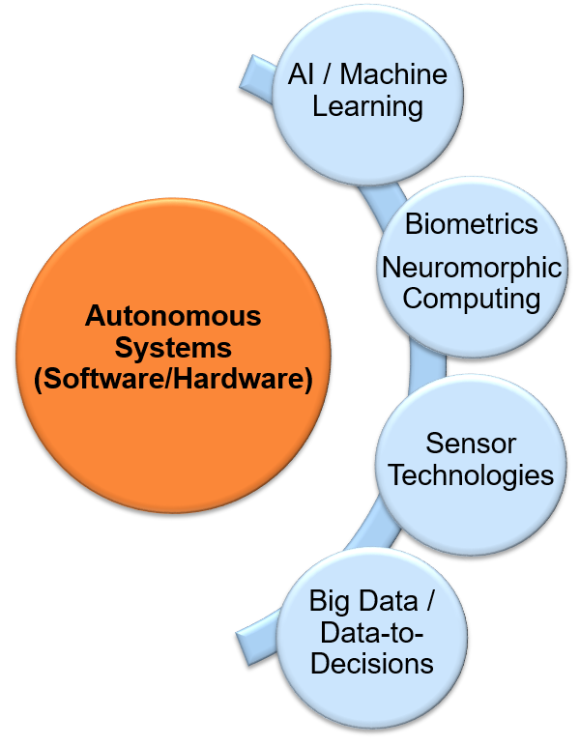
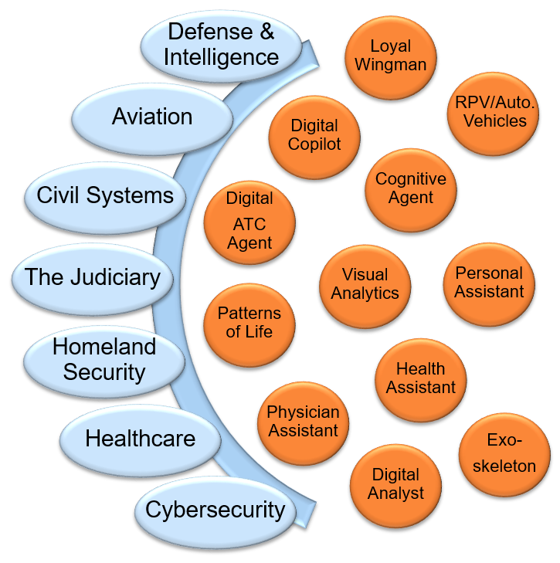
Human-Machine Teams: The Next Frontier for Civil & Military Systems
HMT Video
Machine Partners
Cognitive Augmentation
Individualized
Adaptive
Intimate
Security
Sensitive
Trust/Reliance
Social Dynamics
Emerging Tech Risks/Benefits Example Applications
Notes:
There is tremendous tech potential with the concept of HMT, but we need to address the middle. The video highlights many of those factors.
https://www.youtube.com/watch?v=igWJIfMjuL0
(0:50 – 4:30)
- objective
- tech approach
- results/impact
- next steps
Left - generic buckets of hardware/software applicable to HMT.
Middle - descriptors from the field and the literature that describe the benefits that machine partners can provide and the challenges to getting it right.

Slide 3

Old Wine in New Bottles
Although HMT as seen through the Third Offset is new and emergent, this research space is mature
Problem: People building systems don’t read the research; People doing research don’t understand how to apply it within systems engineering
Researchers
Developers
Notes:
Bridge from: www.mackinacbridge.org.
Disconnect between cognitive engineering and technology development. The technology is mature but the developers aren't aware of or reading the cognitive engineering research on HMT.

Slide 4
HMT Systems Engineering Research
MITRE has undertaken 18 month long effort to convert HMT research into an HMT Systems Engineering process
Applied research ending FY17 has:
Surveyed the research landscape for concrete HMT design/development recommendations
Organized filtered findings into a conceptual framework
Developed general design requirements for each major construct in the framework
Created and piloted a process to tailor the general to the specific (HMT Knowledge Audit)
Used this process in two major work programs:
Air Force Satellite Command and Control
Army Battalion Staff cognitive assistance
Developed a ‘How To Guide’ for broader application

Slide 5
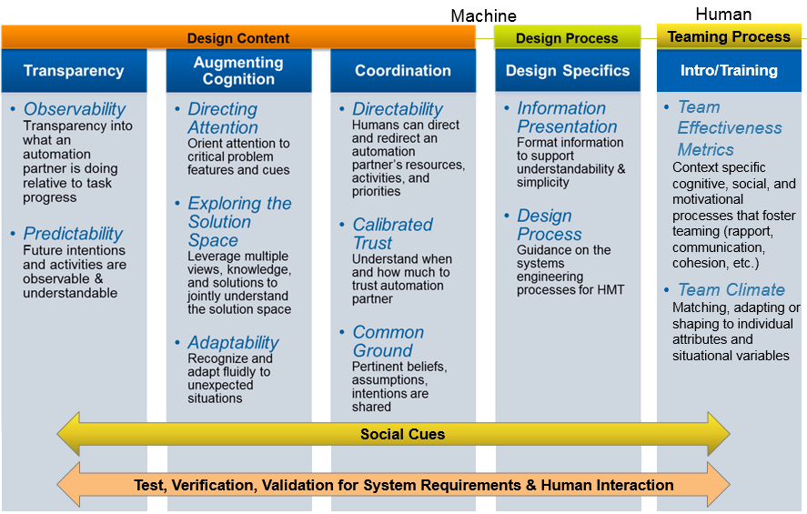
Defining Requirements for HMT Systems Engineering
Notes:
Describe the technical content, origins, meaning of these themes and the structure.
Orange box highlights the content for which general requirements have been developed in FY16-17 MIP in the Trustworthy Autonomy area, along with a HMT SE how-to guide.
Calibrated trust is one of 10 areas that we identified as a leverage point for HMT. It is an emphasis, but HMT goes far beyond just that topic.
This is a generic framework applicable to autonomous systems in general. When applying the requirements or design guidance to a specific system, work is needed to understand the HMT needs of that system through interviews with SMEs and developers. In that process, we have seen that a subset of themes is relevant to a particular system.
There are links between all the columns. For example, observability is applicable to Calibrated Trust (need to know what the system is doing in order to know when to trust it).

Slide 6
Calibrated Trust Example: Army Battalion Staff Planning
Equipment Status
Is it working?
Is it available?
Currently staff member must talk to many different shops for updates
Status dashboard view can enable quick view and drill down of equipment status
Understand when and how much to trust an automation partner
Info sources
Understand the automation/autonomy
The system shall allow the user to view information sources to judge source reliability and promote calibrated trust.
The system shall provide information about the certainty of information.
Notes:
Cite for requirements in lower blue box: Madhavan, P., & Wiegmann, D. A. (2007). Similarities and differences between human–human and human–automation trust: an integrative review. Theoretical Issues in Ergonomics Science, 8(4), 277-301.

Slide 7
Unpacking Calibrated Trust
Considering renaming it “Calibrated Reliance” to focus more on the operator’s behavior of using the automation/autonomy as opposed to the operator’s “feelings” about the technology
Help the user to understand when and how much to trust the automation/autonomy
It’s not about increasing trust in the automation/autonomy
Clarify for users – when automation can be relied upon
when more oversight is needed
when performance is unacceptable
Consider impact of false alarm rates
Trust budget (Auto-Ground Collision Avoidance System as an example)
To calibrate trust, provide information on:
source of reliability
source of diagnostic information
credibility
Notes:
There is a version in backup slides with references as footnotes
Calibrated here refers to the human calibrating their level of trust to the reliability/trustworthiness of the system. Some researchers talk about "increasing trust in the system" but we don't want to increase trust when it's not warranted. Rather, we want the human to understand the capabilities and limitations of the system to they know when and how to trust/use the system. This is helpful so they don't "throw out the entire system" because of one limitation. For example, a tracking system is really good at detecting targets, but tends have false alarms over blue water. Knowing this, the human can adjust to the situation, use recommendations when appropriate, and keep using the system even though it has limitations.
Users tend to develop an initial level of trust in a system and revise it as they interact with the system. Providing this type of info helps the user to understand when and how to trust the system - is it basing recommendations on old or unreliable info?

Slide 8
Exploring the Solution Space example: Army Battalion Staff Planning
Downed aircraft example:
Time distance analysis
Does it take into account …
Weather, this bridge, this terrain
Slopes, go/no-go areas
Impact of elevation on aircraft
Unit type (light, dismounted)
Road width
Leverage multiple views, knowledge, and solutions to jointly understand solution space
Solution Generation
Solution Evaluation
Is it a “best case scenario” estimate?
The automation shall allow a human to input information that wasn’t initially taken into account by the algorithms so the algorithm can incorporate new information or expertise of the human.
Notes:
Time distance analysis – Friendly, Enemy and reserves
In perfect conditions, what is the estimate? May give the best case scenario but with weather and terrain, will take another 45 minutes.
The more the automation knows about the human's perspective, context, and bias, the more helpful the automation could be in understanding implications on the plan. However, it is not necessarily important for the human to justify itself to the system. For example, a planning tool has automation to calculate time it will take for a unit to reach a target. The user may know that the unit is fatigued and can either increase the time directly or drill down into contributing factors (weight, fatigue, etc.) and increase fatigue and see the impact on the calculated time.

Slide 9
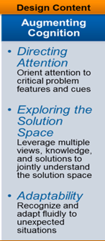
Conclusions
Human machine teaming is much more than trust, or even calibrated trust
Applied research offers guidance for HMT Systems Engineering
Rich conceptual framework for tailoring findings to specific domains
Calibrated trust example: human behavior of the autonomy vs feelings about the autonomy
Automation/Autonomy can be observable, a team player, and augment cognition if designed to do so within systems engineering process
Notes:
This slide is designed to summarize (1) Trust is one important theme of many, (2) trust is ultimately about behavior - will the operators use the system as designed or will they "turn off" features or stop using the tool altogether, (3) the importance of considering the HMT framework in build systems that effectively partner with humans.

Slide 10
Backup Slides

Slide 11
General Calibrated Trust Requirements
Promote Understanding of the Automation
The system shall be designed so that faults are predictable to promote calibrated trust. [6]
The system shall convey system reliability in different contexts:
situations in which the automation can be relied upon;
situations that require increased oversight by personnel;
situations in which the automation’s performance is not acceptable. [3]
The system shall provide context for past performances to explain the reason for any performance decrements. [6]
Prevent Under and Over Reliance
The system shall minimize false alarms in order to help operators develop calibrated trust. [8,46]
The system shall adapt to the cognitive need of individuals in order to reduce task load and prevent over and under-reliance.
The interface shall provide information about the purpose, process, and performance of automation to enhance the appropriateness of trust. [6]
Shed Light on Information Sources
The system shall allow the user to view information sources to judge source reliability and promote calibrated trust. [48]
The system shall provide information about the certainty of information/sources. [48]
Notes:
Numbers in parens refer to source literature (see backup slides)

Slide 12
Unpacking Calibrated Trust
Considering renaming it “Calibrated Reliance” to focus more on the behavior of using the automation/autonomy as opposed to the operator’s “feelings” about the technology
Help the user to understand when and how much to trust the automation/autonomy
It’s not about increasing trust in the A/A
Clarify for users – when automation can be relied upon³
when more oversight is needed³
when performance is unacceptable³
Consider impact of false alarm rates⁸
Trust budget (Auto-Ground Collision Avoidance System as an example)
To calibrate trust, provide information on⁴⁸:
source of reliability
source of diagnostic information
credibility
Notes:
Numbers in parens refer to source literature (see backup slides)—may remove these

Slide 13
Cited References
[3] Joe, J., O’Hara, J., Medema, H., & Oxstrand, J. (2014, June). Identifying requirements for effective human-automation teamwork. In Proceedings of the 12th international conference on probabilistic safety assessment and management (PSAM 12, Paper# 371),(INL/CON-14-31340).
[6] Lee, J. D., & See, J. (2004). Trust in automation and technology: Designing for appropriate reliance. Human Factors, 46, 50–80.
[38] Hancock, P. A., Billings, D. R., & Schaefer, K. E. (2011). Can you trust your robot?. Ergonomics in Design, 19(3), 24-29.
[46] Lyons, J. B., Ho, N. T., Koltai, K. S., Masequesmay, G., Skoog, M., Cacanindin, A., & Johnson, W. W. (2016). Trust-Based Analysis of an Air Force Collision Avoidance System. Ergonomics in Design, 24(1), 9-12.
[47] Lyons, J. B., Stokes, C. K., Eschleman, K. J., Alarcon, G. M., & Barelka, A. J. (2011). Trustworthiness and IT Suspicion An Evaluation of the Nomological Network. Human Factors, 53(3), 219-229.
[8] Parasuraman, R., & Riley, V. (1997). Humans and automation: Use, misuse, disuse, abuse. Human Factors, 39(2), 230-253.
[48] Madhavan, P., & Wiegmann, D. A. (2007). Similarities and differences between human–human and human–automation trust: an integrative review. Theoretical Issues in Ergonomics Science, 8(4), 277-301.

Slide 14
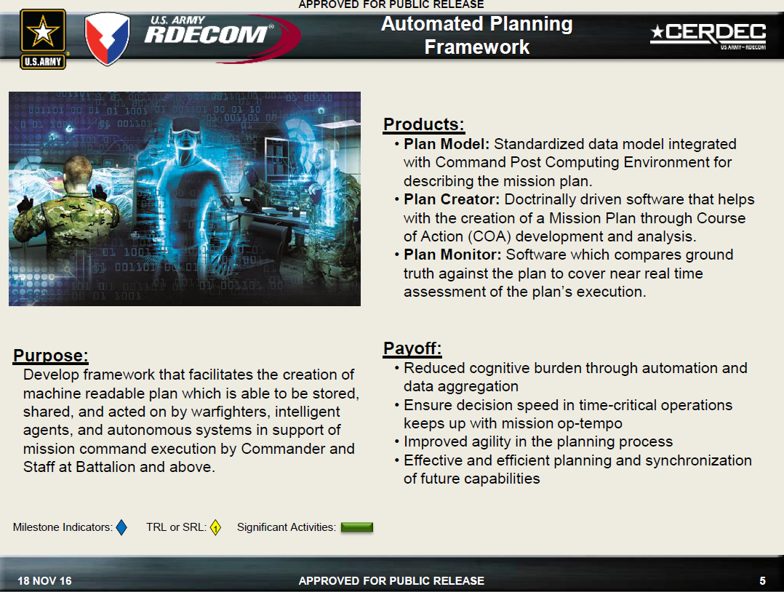
Army Automated Planning Framework Background
Notes:
From AAAI conference presentation by Kenneth Grippo, Chief, Decision Science Branch, Mission Command Capabilities Division, Command Power & Integration Directorate, 18 Nov 2016

Slide 15
Knowledge Audit for HMT: Sample Questions
2. Big picture -> Observability
What do you want the automation to tell you as it’s working for you?
Are you ever confused about what the system is doing?
E.g., What mode or level of automation the system is in, How the system calculated a recommendation
What are the key vital signs to know that you are on track to accomplish the mission?
How might automation help you coordinate info more effectively, if at all?
Purpose
Better understand the overall health and status of total human-machine team, in context of the mission, environment, and organization.

Slide 16
Knowledge Audit for HMT: Sample Questions
7. Job smarts: Overall capability of automated/ autonomous partner
*If the government was giving you an intelligent robot/digital team member (like C3PO), what are the top things you’d like it to do for you?
*On the flip side, what would you not want your robot/digital team member to do?
If you had automation to help, what tribal, or local knowledge would it need to be aware of to be effective?
Are there administrative, information seeking, or representation tasks that your automated partner could do to make the team more efficient and effective?
E.g., rapid lookup of phone numbers for mission partners
Tip
If you have limited time, be sure to ask the *questions. They have high payoff.
Tip
Listen for clarifying comments about automation prerequisites, e.g., “that would be great, as long as the automation is/can…”

Slide 17
Heuristic Evaluation Questionnaire
Description of heuristic
Theme
Observability
HE Question: Observability means the system proactively communicates with you to let you know what it’s thinking and doing, and tells you how far along it is in accomplishing your joint work.
Example: your GPS/directions app telling you that it’s rerouting
you because there is an accident ahead.
I rate this system’s Observability as: High, Medium, Low? (Circle one)
What aspects of the system are observable?
What aspects of the system should have greater observability?
Example
Rating
What is done well?
What could it be improved?

