Slide 1
Digital Copilot Cognitive Assistance for Solo Pilots
Center for Advanced Aviation System Development
John Helleberg
November 9, 2017
Notes:
Good Morning, my name is John Helleberg and I will be introducing you to the Digital Copilot concept.

Slide 2
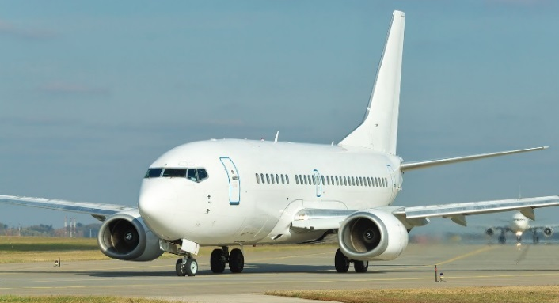
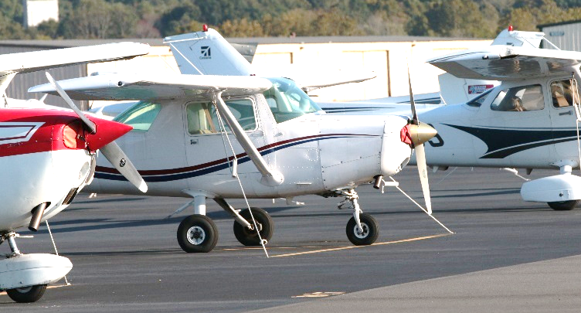


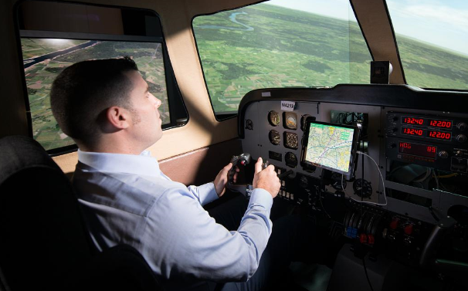
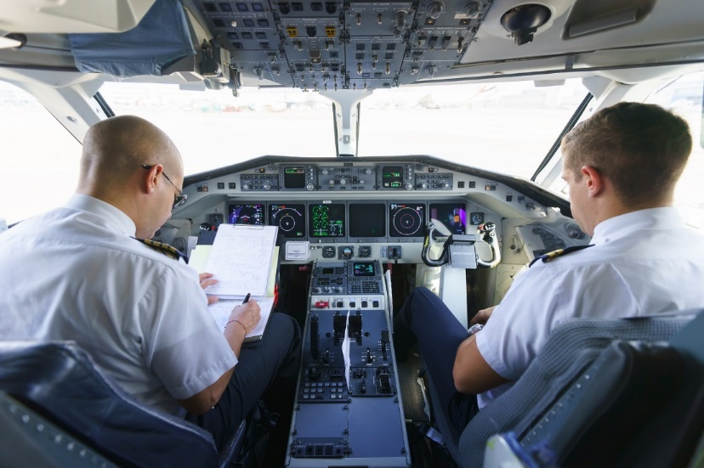
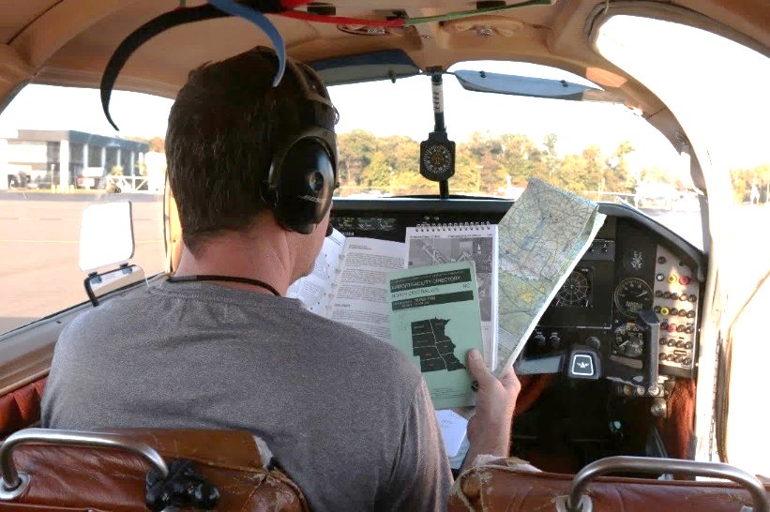
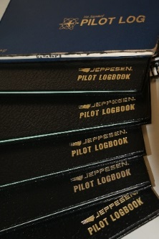
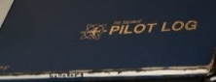
GA Safety Challenge
Better Training
More Experience
Multi-Engine, Traffic and Terrain Avoidance, etc.
Single-Engine, Lack Redundant Systems, etc.
Better Equipped
Crew Operation
Notes:
Airlines… better safety record. Reasons include most GA aircraft don’t have redundant equip or multi-engines.
Also, a large portion of GA pilots fly recreationally, means they tend to fly less often and have less overall experience.
On top of all that, the majority of GA pilots are flying solo… they take on all the workload and don’t second pair of eyes to crosscheck what they are doing.

Slide 3
GA Safety Challenge
Solo flight is riskier than flight with a crew
Second set of eyes improves safety
Single-pilot accident rate is ~ 3 times higher than crew rate
Single-pilot fatal accident rate is ~ 13 times higher than crew rate
Robert E. Breiling and Associates' 2010
Notes:
Research… single-pilot ops (the majority of GA flights) are riskier than two pilots
Takeaway message “having a second set of eyes improves safety”

Slide 4
Why?
Information overload
Distraction
Loss of Situation Awareness
Holding
ATIS or AWOS
VFR or IFR
Alternate
DH or MDA
SUA
Tower Hours
Time
Distance
?
Visibility
AVGAS
NOTAMs
Pattern Altitude
Ceiling
?
?
?
?
Pattern Entry
?
?
Checklists
?
Notes:
There's no mystery as to why this is:
Flying an aircraft by yourself is demanding.
Lot of information competing for the pilot’s attention and they must attend to
the correct information, at the correct time, and avoid any distractions
otherwise they can lose SA or as pilots call it, “get behind the airplane,”
Sometimes… precursor to an accident.

Slide 5
Objective – Improve GA Safety
Benefits of
Crew Resource Management
Single Pilot Cockpit
Notes:
In partnership with the FAA, a group of MITRE engineers… HF, SW, Pilot… improving GA safety… Initial idea - explore concept of Digital Copilot
Objective - bring benefits of CRM to the single-pilot cockpit.

Slide 6
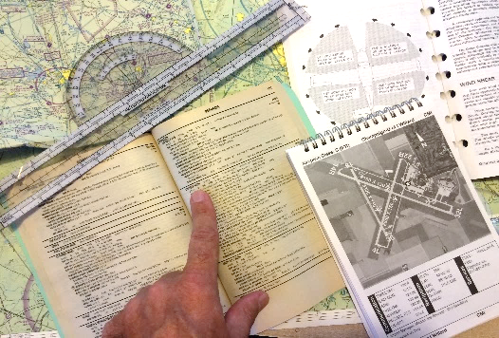
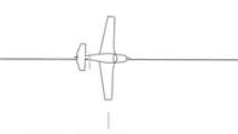
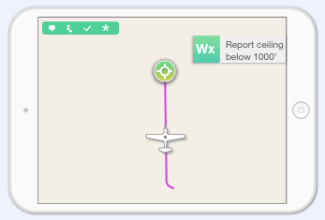

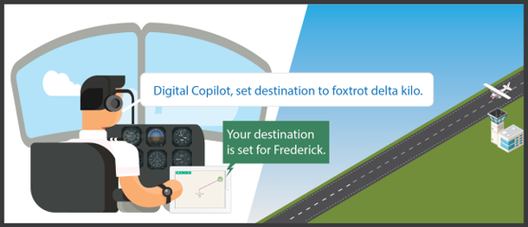
Support for Single Pilots
ATIS Frequency for Manassas is 125.175
Right Information
Right Time
Right Format
Notes:
In developing this concept, we wanted to provide the right information at the right time in the right format.
This can help reduce pilot workload related to searching for and retrieving information by automatically presenting…
Important information based on inferring pilot’s intent within the flight context.
For example, reading checklists, monitoring altitude, alerting to nearby airspaces, etc.

Slide 7








What is Digital Copilot?
Cognitive Assistant
Safety Features
Checklists
Terrain
Conformance
Monitoring
Holding
Airport Info
Pilot
Destination Info
Weather Notices
Reminders
Notes:
It is a Cognitive Assistant that can monitor the flight and provide pilots with “just-in-time” information based on the flight context.
It includes a set of Safety Features that highlight the various aspects of DCOP concept.
Some features provide info automatically, others enable the pilot to request relevant information on demand.

Slide 8




How Does Digital Copilot Work?
Cognitive Assistant
Safety Features
Checklists
Terrain
Conformance
Monitoring
Fly to Frederick
Inferred
Destination
Pattern Leg
Phase of Flight
Holding
Pilot Intent Logic
Airport Info
Pilot
Destination Info
Weather Notices
Reminders
Notes:
Heart of Digital Copilot is a set of algorithms that help it understand what the pilot is trying to do.
These algorithms use position and other environment information to predict the pilot’s intent
Based on this understanding, DCOP can provide pilots with relevant information at just the right time.

Slide 9
How do Pilots Use Digital Copilot?
Cognitive Assistant
Safety Features
Checklists
Terrain
Conformance
Monitoring
Inferred
Destination
Pattern Leg
Phase of Flight
Holding
Pilot Intent Logic
Airport Info
Interactions
Pilot
Destination Info
Weather Notices
Reminders
Notes:
Also developed a natural and intuitive way… interact with DCOP.
Pilots can simply speak to DCOP… it will provide information back to the pilot verbally (much like a human copilot).
DCOP also provides information visually as appropriate.

Slide 10
Digital Copilot
Cognitive Assistant
Safety Features
Checklists
Terrain
Conformance
Monitoring
Inferred
Destination
Pattern Leg
Phase of Flight
Holding
Pilot Intent Logic
Airport Info
Interactions
Pilot
Destination Info
Weather Notices
Reminders
Notes:
To summarize, developed 25 unique features… core set of algorithms (intent)… and intuitive way to interact.
Ultimate goal… transfer DCOP to industry…
in order to have impact on safety… technology needs to be integrated into systems pilots use today.
Also note, DCOP concepts… portable devices, avionics of the future, or even scale up to support crewed operations.
Next I would like to show you a brief video that describes the concept and shows some of the features.
(Only if asked) MITRE charges a small fee to defray administrative costs associated with Tech Transfer

Slide 11
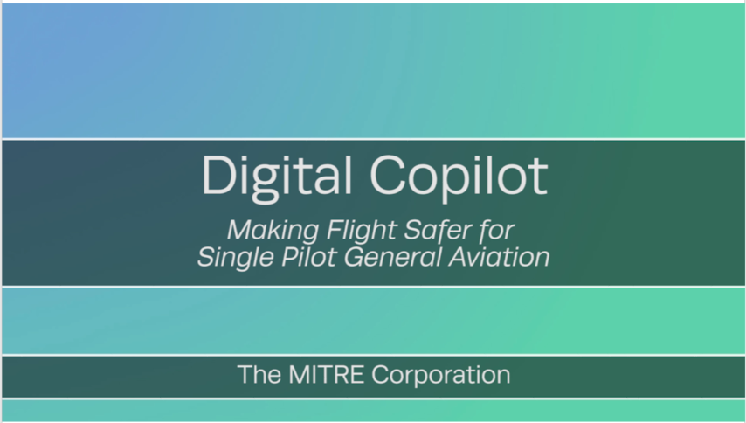
Link to video
YouTube link

Slide 12

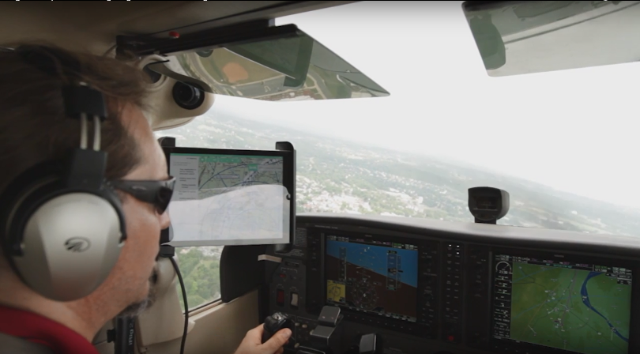
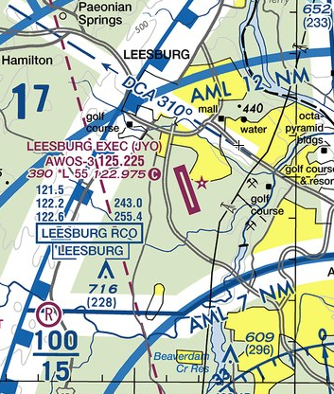
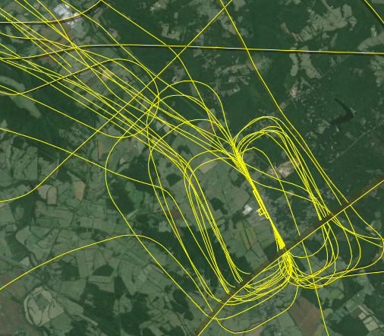
Research and Development
Pilot Workshops
Flight Tests
Lab Studies
SkyVector.com
Google Earth
Notes:
Now let me talk a little about the research and development that has gone into the Digital Copilot
Focus of research… determine info beneficial to safety (right info)… when to provide info (right time)… how best to present info (right format)
Began with workshop… MITRE pilots varied background… Solicit feature ideas… help single pilots… validate our ideas
Once developed core algorithms/features… tested DCOP in simulator… 14 local GA pilots… evaluate features/maturity/opinion – workload/safety. Overwhelmingly positive - extremely rare
Also tested DCOP - actual flight… Used a typical Cessna 172 with no modifications and connected tablet to intercom… performed well
Some video you saw earlier shot while flying.

Slide 13



Technology Transfer Plan
Software Manufacturers
Hardware Manufacturers
Aviation Community
Magazine Articles
Notes:
Ultimate goal… transfer DCOP to industry… In order impact safety, technology - integrated systems pilots use .
We are disseminating concept magazine articles… working with HW and SW… incorporate technology into their products.

Slide 14
Questions?
THANK YOU!

